Slide 1
Cyber
Security
THAILAND

Slide 2




Cloud
SECURITY
Intensive

Slide 3
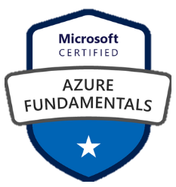
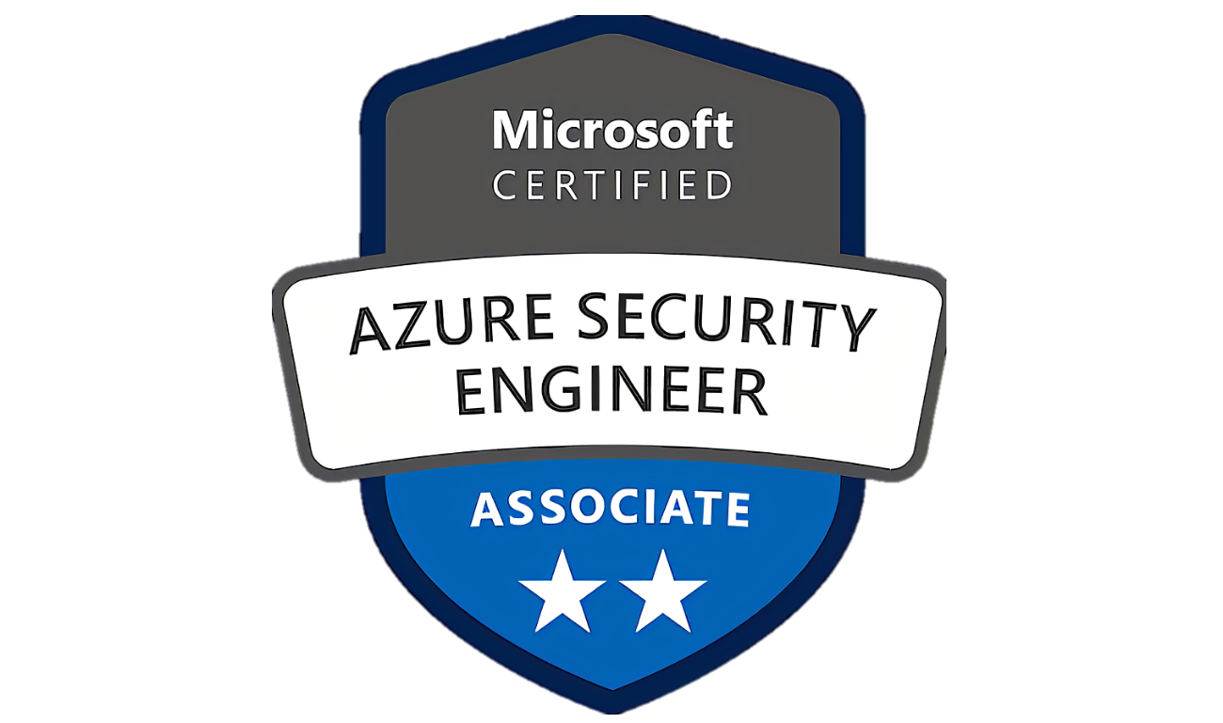
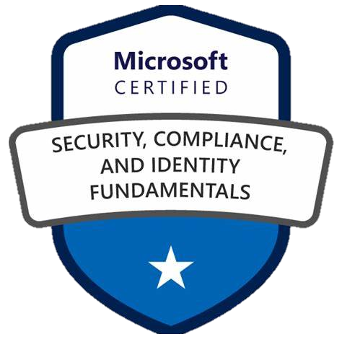
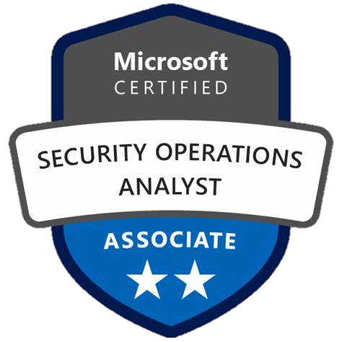
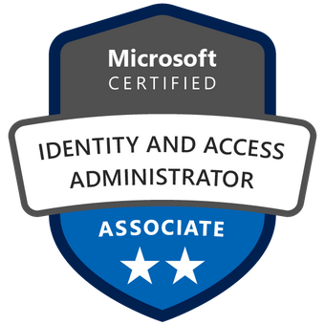
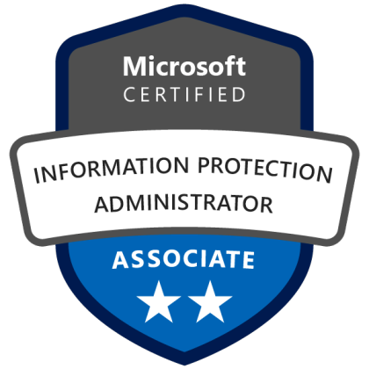
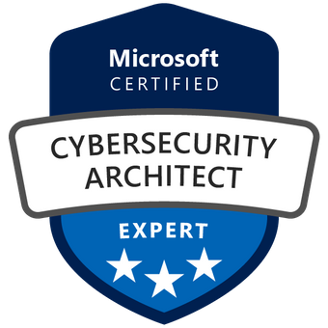



6
Certification
Path
MS Cert
MS Applied Skills
CSP-Agnostic

Slide 4

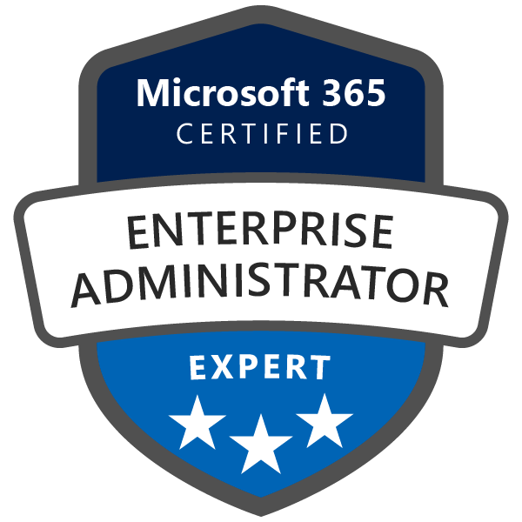
90 USD each
Certification
Proctored
100 mins
Random Labs
Path
Recert Free
Free Online Practice
Open Book
SC-200
SC-300
SC-100
AZ-900
SC-400
AZ-500
MS-102

Slide 5
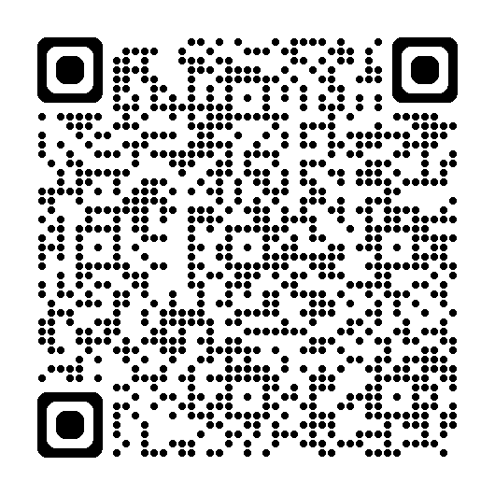
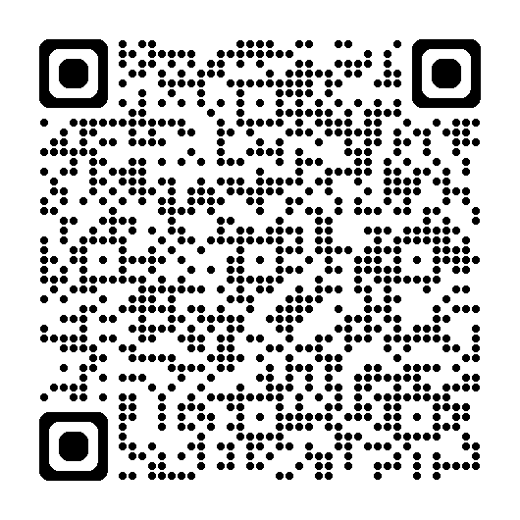
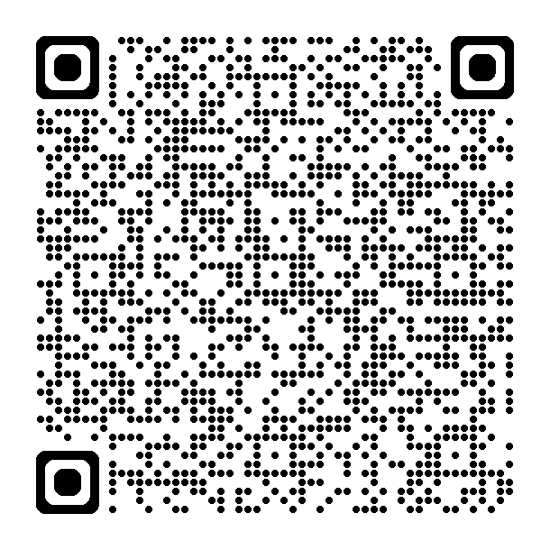
Applied
Skills
Lab Network
Lab Sentinel
Free On-demand Lab exam
Lab Defender for Cloud
learn.microsoft.com/credentials
>> Browse Applied Skills

Slide 6
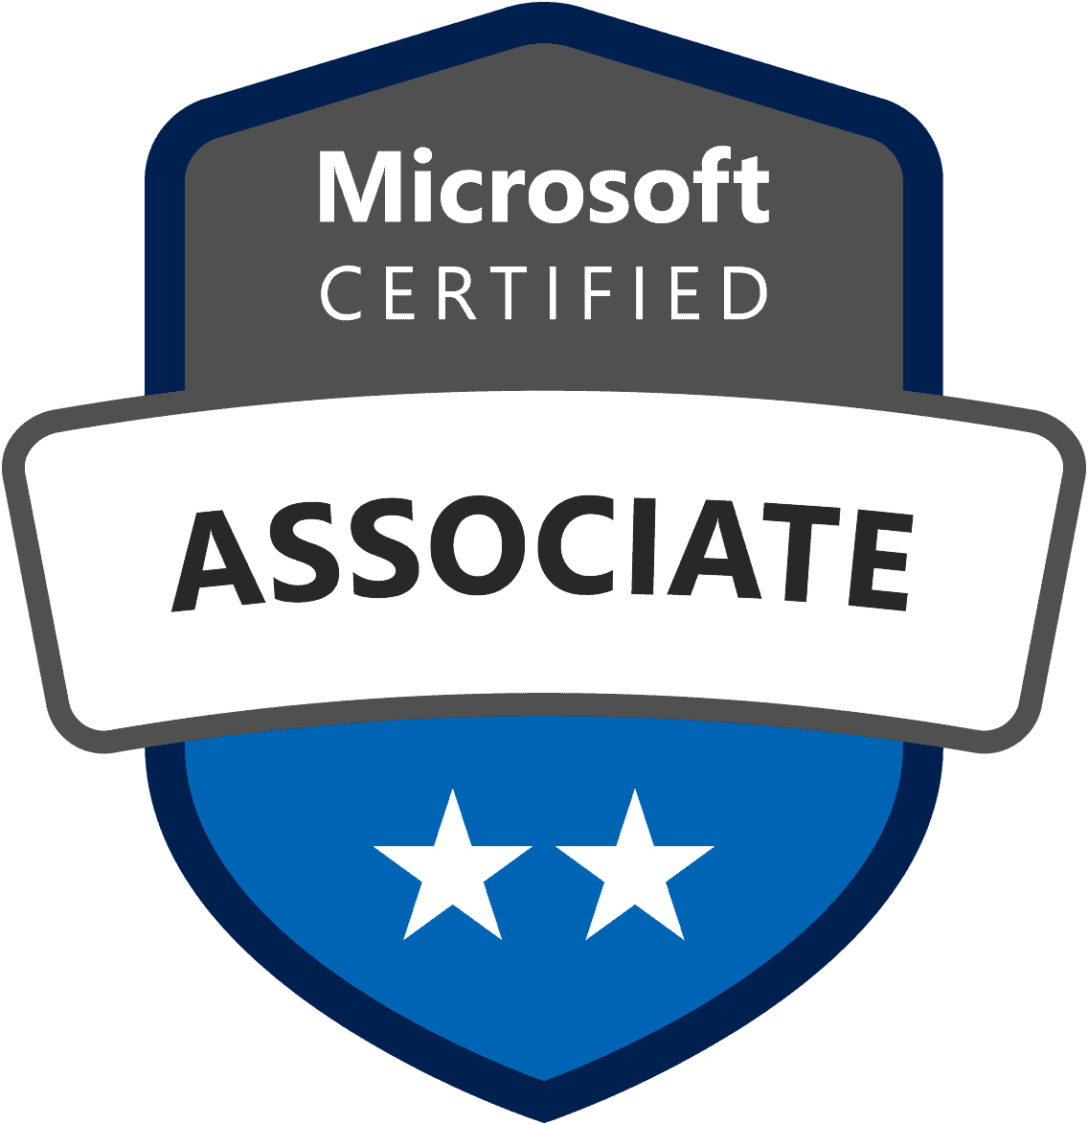
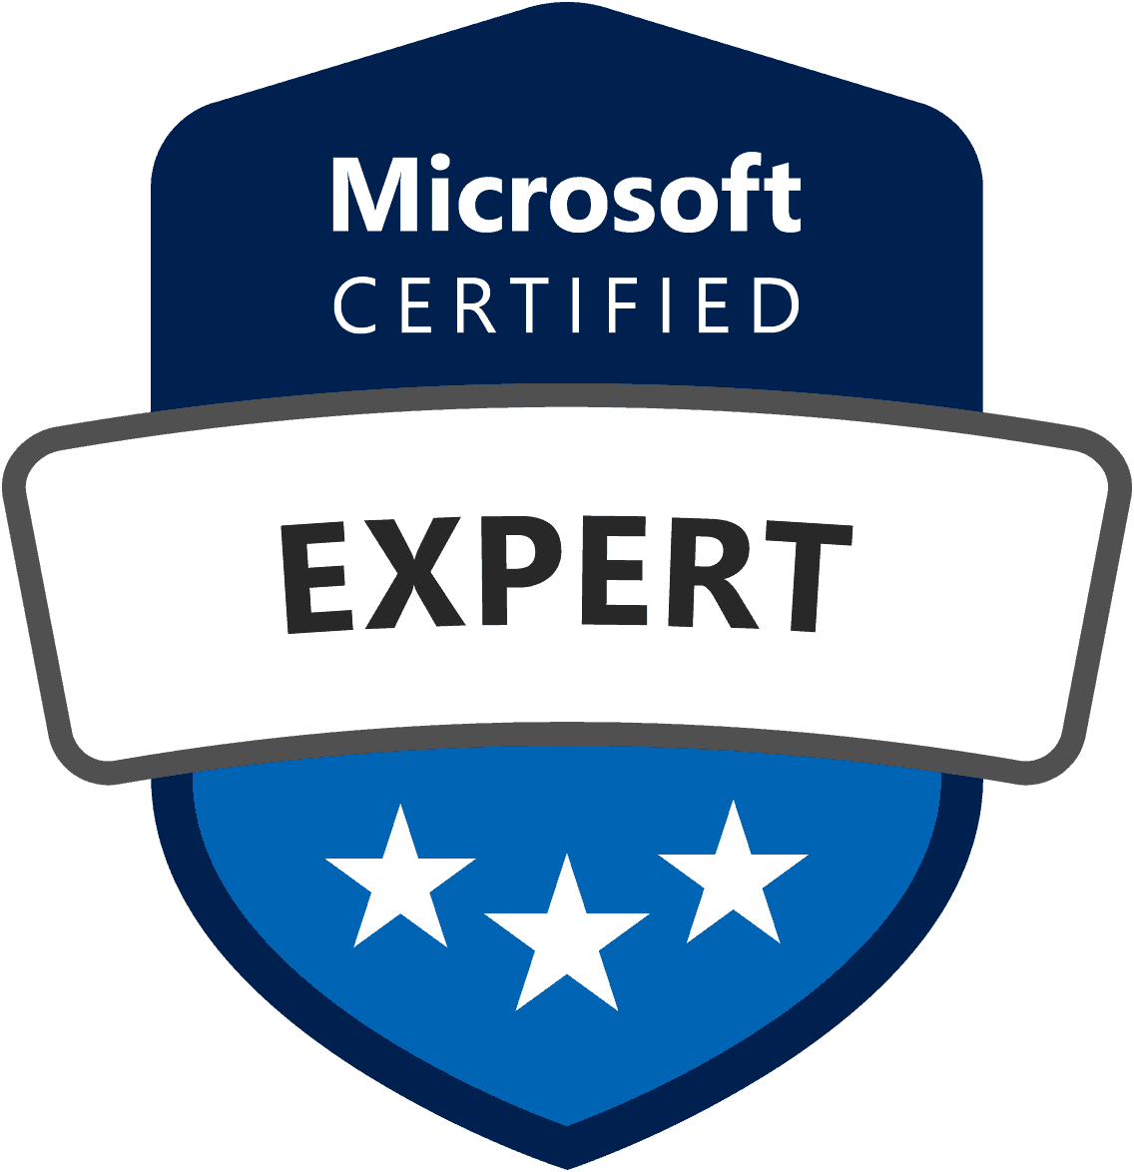
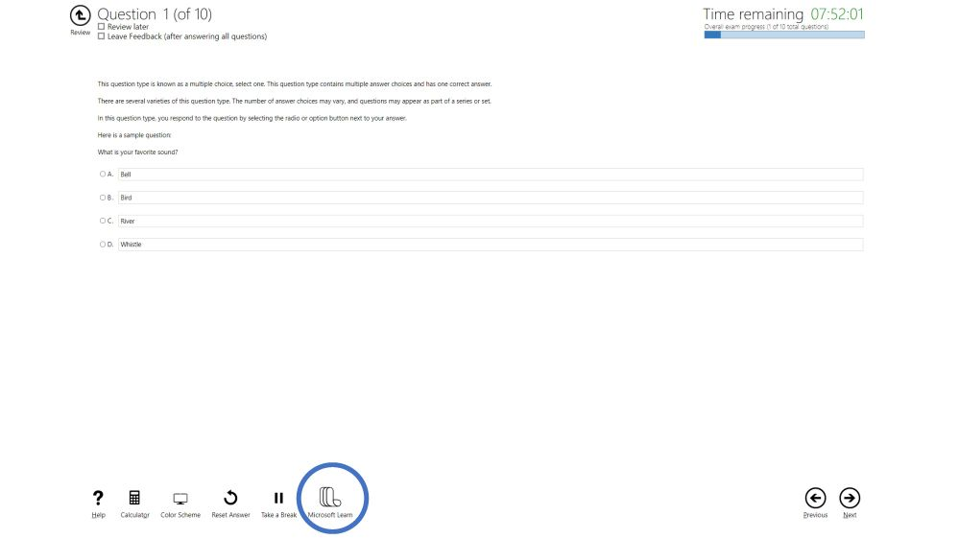
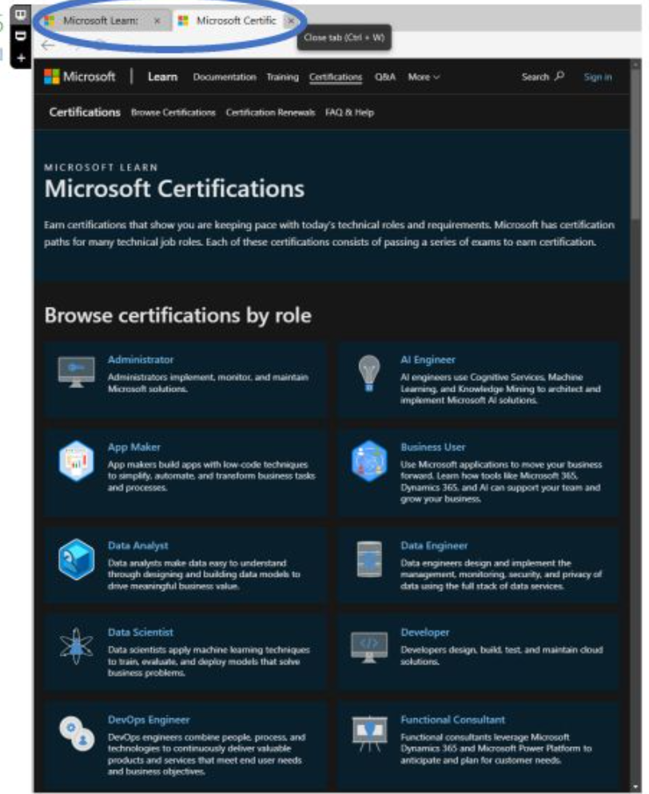
learn.Microsoft.com
Open Book
Exam

Slide 7
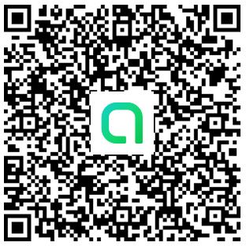
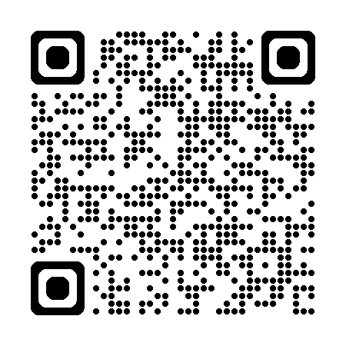
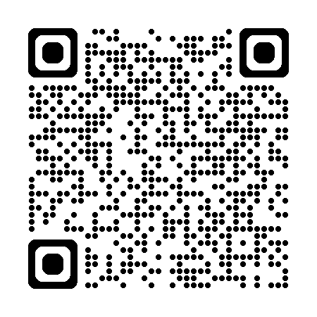
Join
Community
MS Cloud Squad LINE OpenChat
fb.com/SparkTechTH
fb.com/groups/MicrosoftSCIcommunityThailand

Slide 8

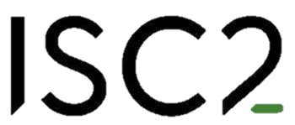
395 USD = 2 attempts
by
On-demand Open-book
90 mins 60MCQ
CSP-agnostic
599 USD
Proctored
4hrs 150MCQ
by
x CSA ++
Exp Endorsed

Slide 9
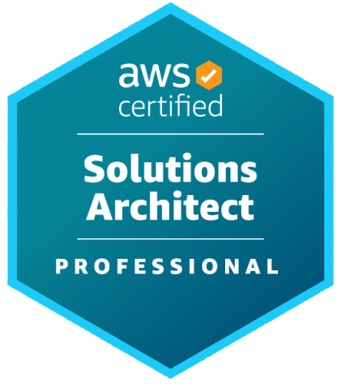
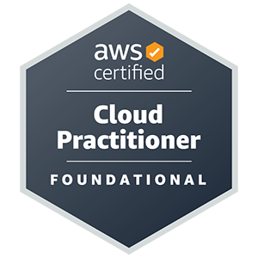

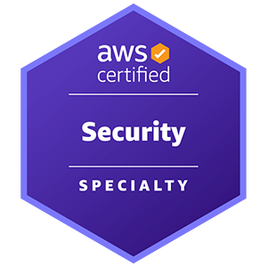
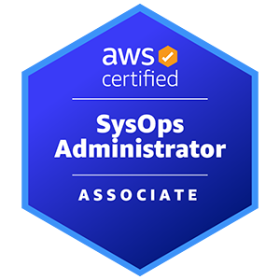

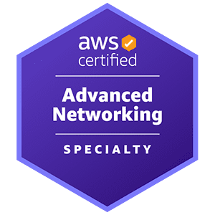

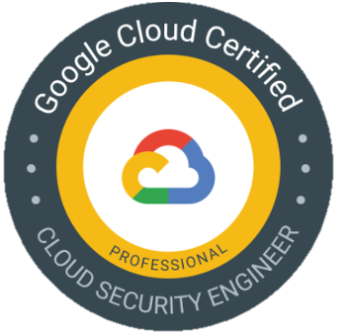

Expand!

